Slide 1

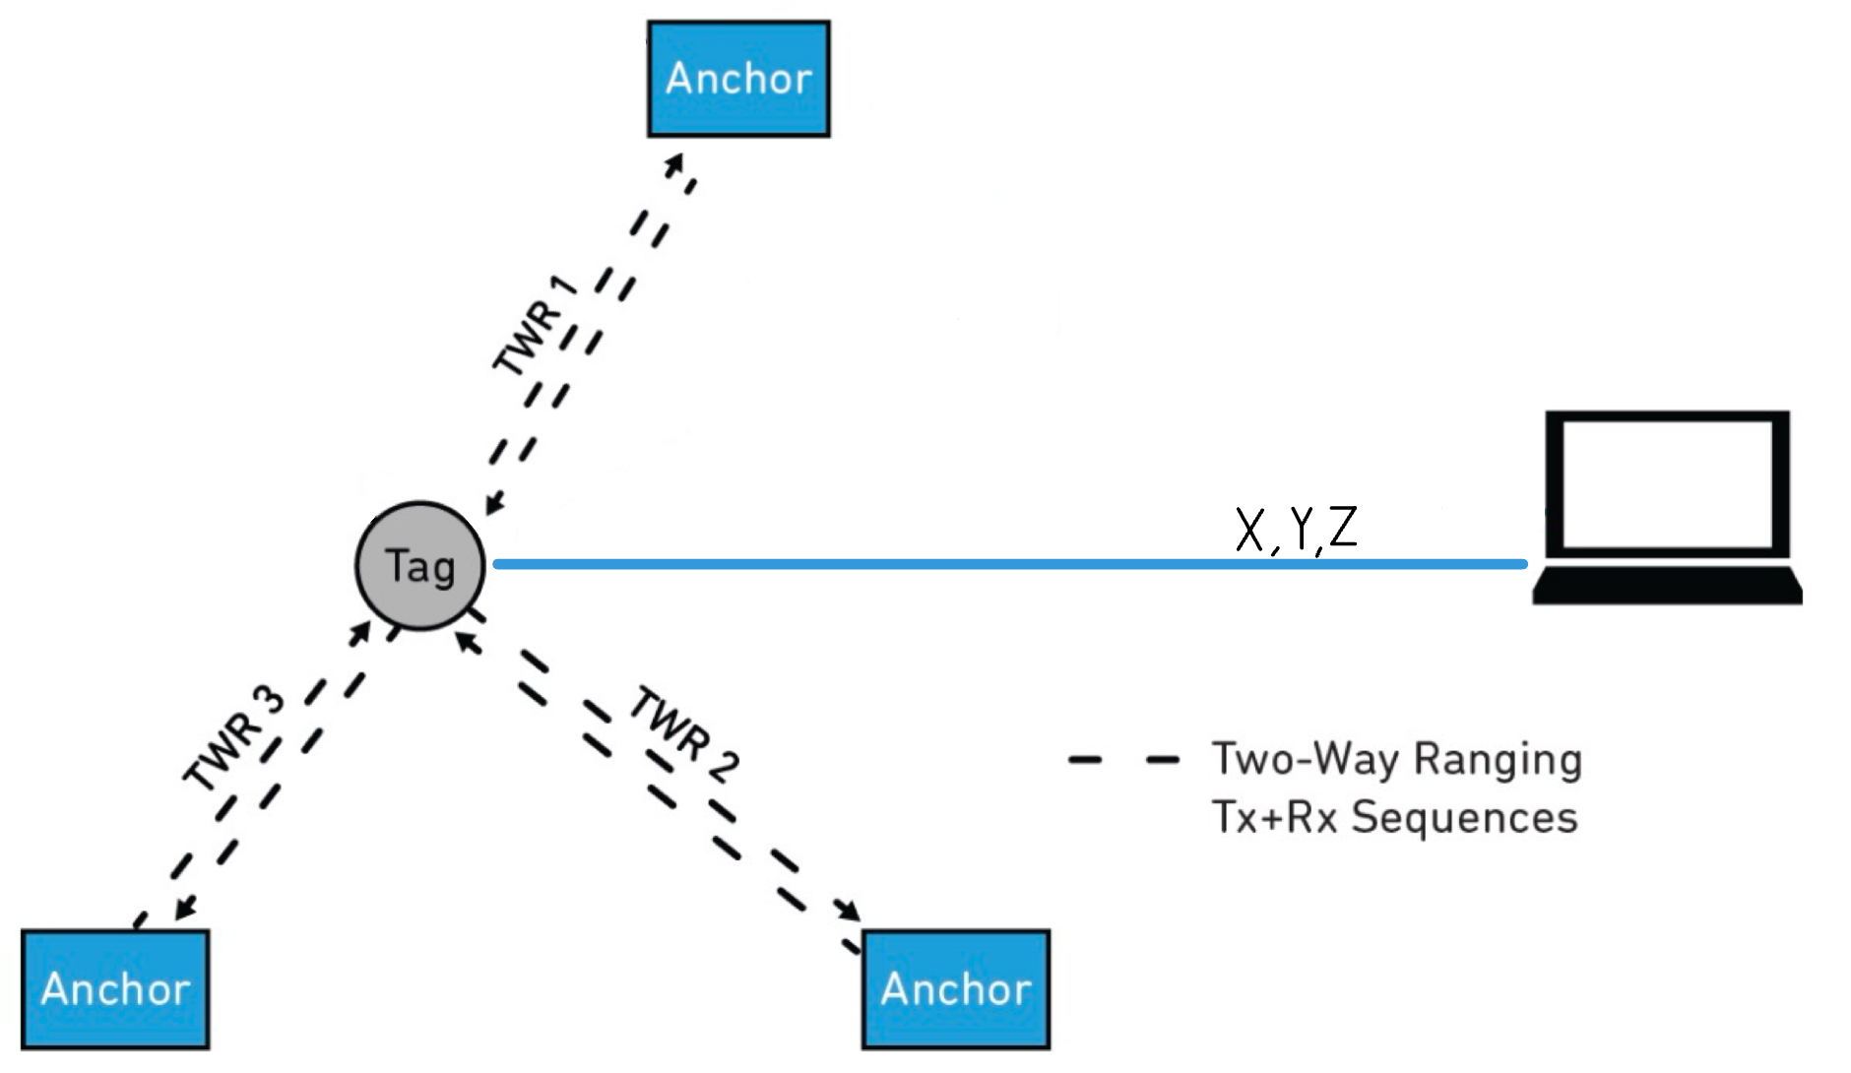
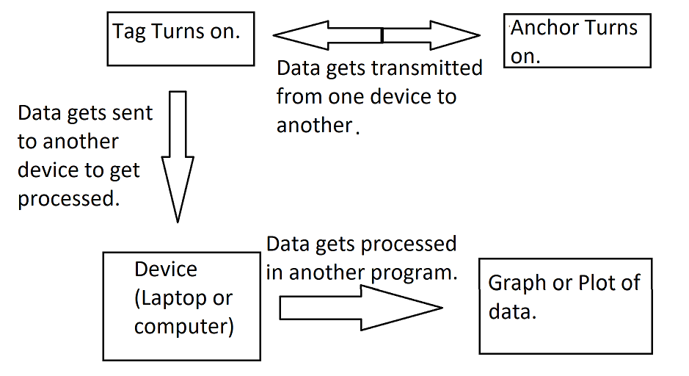
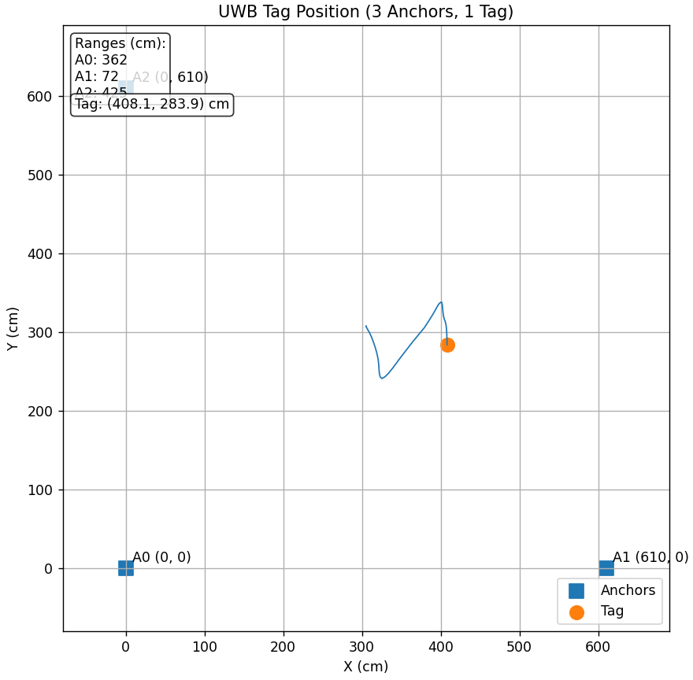
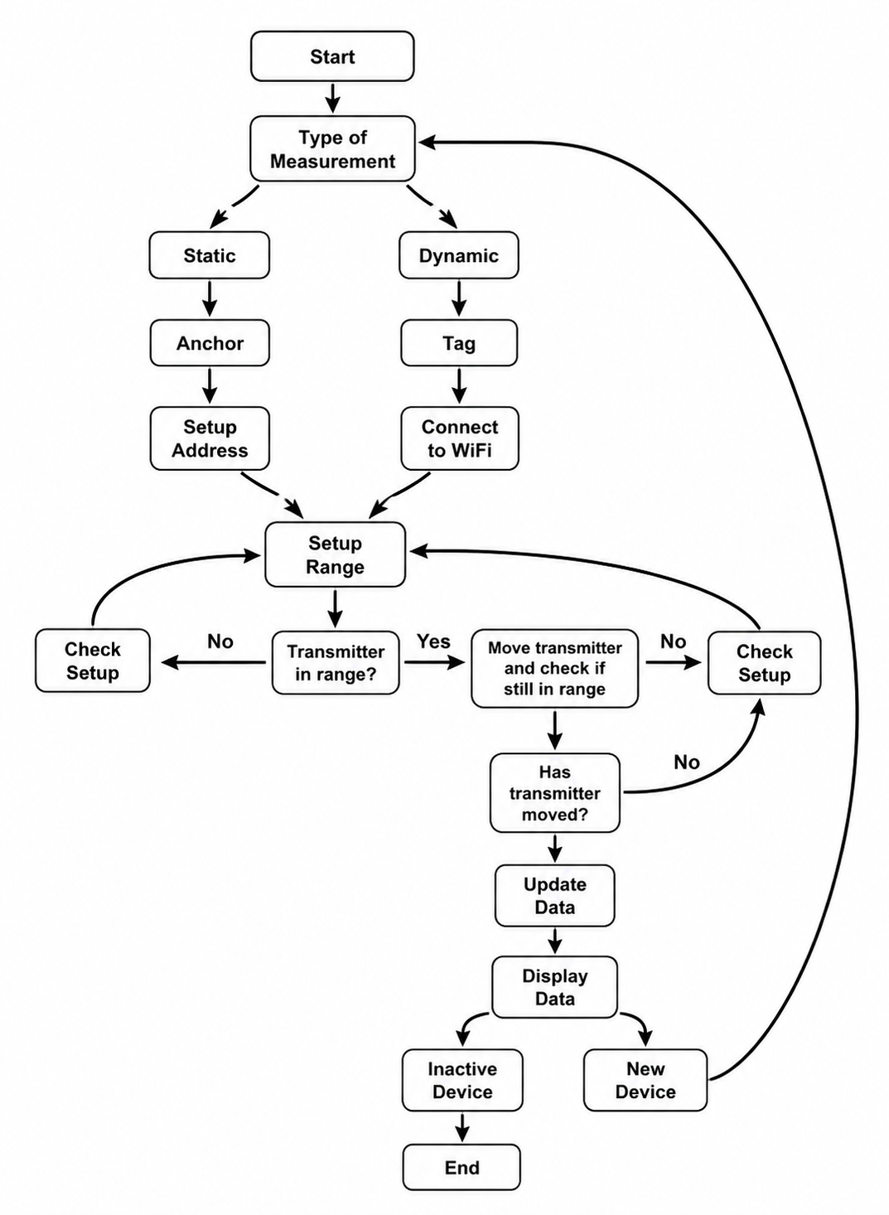
Electrical Engineering Department
Indoor Location Tracker
Project Advisor: Sotoudeh Hamedi-Hagh
Garcia, Anthony (BS Electrical Engineering) Nguyen, Kevin (BS Electrical Engineering)
Huynh, Tommy (BS Electrical Engineering) De La Luz, David (BS Electrical Engineering)
Introduction
Methodology
Summary/Conclusions
This project’s objective is to create a wireless location tracker to monitor people or objects indoors. The motivation behind this project is that other location systems, such as GPS, have poor accuracy indoors due to signal being blocked or attenuated by the building’s roof and walls.
Our design consists of an off-the-shelf wireless board that utilizes the ultra wideband (UWB) communication protocol. UWB is well suited for indoor positioning use. A high bandwidth of 500 MHz+ allow for high positional accuracy of up to the order of centimeters [1]. UWB is also resilient to multipath effects, which is when a signal travel along several paths to a receiver due to bouncing off of walls or floors [1]. These multipath conditions can cause interference or data errors. Thanks to its high bandwidth, UWB signals can have a shorter pulse in time, which provides resistance to multipath effects.
The goal of the system is to be able to observe the location and movement of a tracking beacon in real time and visualize the motion on a plot. The system consists of a tracking tag and three anchors at fixed points in a room. Communication between the tag and anchors allow for the distance between the tag and each anchor to be computed. These distances are then used to triangulate the tag’s position relative to the anchors.
The Indoor Location Tracker successfully achieved the goal of being able to track and plot the location of the tag in real-time. During testing, the tag was moved toward an anchor, and the position plot accurately reflected this motion. Therefore, the system works as intended. There is a noticeable delay between the tag’s motion and the position updating on the plot. However, the delay is only up to a few seconds, so the system can still reasonably be used for real-time tracking.
Future iterations can focus on increasing the number of anchors to expand tracking range and improve tracking accuracy. Reducing the delay between the tag’s movement and the corresponding position marker updating on the plot could also be an area of improvement.
Analysis and Results
The tag's location (x,y) is calculated by solving for the intersection of three circles centered at each anchor (x_{i}​,y_{i}​​) with a radius equal to the measured distance di​:
(x−x_{i}​​)²+(y−y_{i}​)²=d_{i}​²​
This Two-Way Ranging (TWR) method ensures that timing errors between the mobile tag and the ESP32-based anchors are minimized, providing reliable coordinates for the final display.
How the Code itself works is there will be two types of receivers. One being the tag which will be dynamic with it moving around. The other being the anchors which are static and will stay in one spot. The tag will attempt to connect to wifi which in turn appears on a separate device. This device will help generate the display. The anchors will set up addresses to help store the data being transmitted. The range will also be calibrated and the tag will be tested. The tag will move and will in turn update the data in the display. Once finished, all receivers can be turned off.
Key References
[1] P. Dabove, V. Di Pietra, M. Piras, A. A. Jabbar, and S. A. Kazim, “Indoor positioning using Ultra-wide band (UWB) technologies: Positioning accuracies and sensors’ performances,” in 2018 IEEE/ION Position, Location and Navigation Symposium (PLANS), IEEE, Apr. 2018, pp. 175–184. doi: 10.1109/plans.2018.8373379.
[2] everythingRF, “What is Ultra-Wide Band (UWB) Technology?” Accessed: Nov. 29, 2025. [Online]. Available:https://www.everythingrf.com/community/what-is-ultra-wide-band-uwb-technology
[3] Playful Technology, “Ultra Wideband Realtime Location System using ESP32 and Unity,” YouTube, https://www.youtube.com/watch?v=-GNkobAxao0 (accessed Dec. 1, 2025).
[4]https://wiki.makerfabs.com/MaUWB_ESP32S3%20UWB%20module.html
[5] Qorvo, “Getting Back to Basics with Ultra-Wideband (UWB),” May 2021. [Online]. Available: https://www.qorvo.com/resources/d/qorvo-getting-back-to-basics-with-ultra-wideband-uwb-white-paper
Methodology
The wireless board used was made by MakerFab and consists of an ESP32 microcontroller and DW3000 UWB chip. It is powered using a 3.7V 500 mAh LiPo battery. Our system consists of 4 of these boards with one acting as the tracking tag and the other 3 as anchors.
The board will be using two-way ranging, which is a method to measure the distance between two devices between each other. In this case, the tag and anchor will bounce data between each other and then send it to the device to process the data. Then, the data will process into a display. For this case, there will be three anchors and one tag. The anchors will be placed around the room, with the area being around 20 feet. One of these devices will send a signal to another device. This device then records the time measured and sends the signal back to the first device. This process repeats with all anchors and tags. Then, the data will be sent to the program to generate a display.
The plot above shows the calculated X,Y coordinates as the tag was moved in a linear path. The tag-anchor system is clearly able to track the tag’s motion with good accuracy. However, there is some delay between the tag’s actual position and the tag’s marker on the plot when the tag is moving. This latency is likely due to time taken to process and transmit the data and perform necessary calculations. The delay between tag movement and the plot updating is usually a few seconds, which is still acceptable and reasonable if the system is to be used for real-time position tracking. It was also noticed that calibration of the anchors was needed to ensure position accuracy. When the distance between anchors was changed without re-calibration, the tracking accuracy is much worse. This means that when the tag-anchor system is deployed in a new room or arrangement, calibration must be redone.
Acknowledgements
We would like to thank our project advisor, Professor Sotoudeh Hamedi-Hagh, for his technical guidance throughout the semester. We also appreciate the SJSU Electrical Engineering Department for providing the IEEE lab facilities and equipment for our use.
We deployed the system in a controlled 20×20 foot indoor environment. Anchors were positioned at fixed XY coordinates to provide a reference frame. Calibration of the anchors was performed in order to ensure the anchors know the distance between each other. This is necessary to ensure tracking accuracy.

